Slide 1







MSIS 2606 | Team 1: Scrumtastic
Samiksha Khare
Scrum Master
Emily Su
Product Owner
Dhvanil Sanjay Shah
Support Engineer
Chen Chen
Software Developer
Ashley (Jia) Yan
Software Tester

Slide 2
Our Company and Proposal
Company Overview: Eco-Friendly Furniture Co. is a forward-thinking furniture manufacturing company dedicated to producing sustainable and environmentally friendly furniture solutions.
Mission Statement: To minimize our environmental footprint while providing high-quality, stylish, and functional furniture for homes and businesses.
Business Problem: Eco-Friendly Furniture Co. faces inefficiencies in managing environmental impact data, exacerbated by growing operations and data volume. Current reliance on Excel files in SeedDMS leads to decentralized data, manual analysis, and hampers decision-making, compliance, transparency, and cost-saving efforts.
Our Proposal : Environmental Management System
We're creating an EMS web app with MySQL backend, compatible with SeedDMS, for Eco-Friendly Furniture Co. It centralizes environmental data, ensures security with user authentication, and empowers analysis with Python, enhancing decision-making and transparency.
Our Proposal : Environmental Management System ​
We're creating an EMS web app with MySQL backend, it centralizes environmental data, ensures security with user authentication, empowers data visualization with Python, and enhance decision-making and transparency.
Notes:
Today, we're here to present our company, Eco-Friendly Furniture , which is a forward-thinking furniture manufacturing company in San Francisco.
Our mission is to offer stylish and functional furniture while minimizing environmental impact.
`
In our business, we are required to comply with California's Mandatory Reporting of Greenhouse Gas Emissions regulation and failing to do so can result in substantial penalties.
Currently we are using excel files to enter the data related to Energy Consumption, Material Sourcing, and Waste Generation. But as our operations grow, maintaining these files are becoming more difficult. Additionally, if we want to retrieve some specific information it requires lot of time and efforts.
So, to tackle all these Challenges, our proposal is to create a centralized Environmental Management System (EMS. This sytem will track our carbon footprint, allow us to streamline decision-making capabilities, and ensure regulatory compliances.

Slide 3
Why MySQL?
When selecting the backend database management system for our EMS, we also considered PostgreSQL and SQLite. Through our competitive analysis, we concluded that MySQL was most suitable because of its compatibility with SeedDMS and reliable performance.
Strengths | Weaknesses
World’s most popular open-source database with a global community^{1, 2} Compatibility and integration with SeedDMS⁵ Cost-effective Reliable performance for structured data | Complexity in large scale implementations Limited built-in analytics Complex transactions may encounter difficulties (i.e., deadlock, lock contention)³
Opportunities | Threats
Integration with IoT technologies Cloud-based Solutions Customization for sustainability reporting | Competing database technologies Security vulnerabilities Potential regulatory compliance risks
[1] Statista. (2023 Sep). Worldwide popularity ranking of database management systems. Retrieved from https://www.statista.com/statistics/809750/worldwide-popularity-ranking-database-management-systems/
[2] MySQL. (n.d.). About MySQL. Retrieved from https://www.mysql.com/about/
[3] Kwong, L. G. (2021, Oct 31). Understand the Basics of Locks and Deadlocks in MySQL - Part I. Medium. Retrieved from https://lynn-kwong.medium.com/understand-the-basics-of-locks-and-deadlocks-in-mysql-part-i-92f229db0a
[4] Min-Hank Ho, VP Product Management (2023, Sep 13). Data Security in MySQL is an evolving compliance and threat landscape. Retrieved from https://baffle.io/blog/data-security-in-mysql-is-an-evolving-compliance-and-threat-landscape/
[5] SeedDMS. (2024). About. Retrieved from https://www.seeddms.org/about/
Notes:
Addressing weaknesses/threats: Weaknesses
Complexity in Large Scale Implementations
Mitigation Strategies:
Expert Consultation: Engage with MySQL experts or hire experienced database administrators (DBAs) to design and implement the database architecture.
Scalability Solutions: Utilize MySQL features like sharding, replication, and partitioning to handle large-scale data efficiently.
Infrastructure Investment: Invest in robust hardware and network infrastructure to support large-scale operations.
Automation Tools: Implement automation tools for database management tasks to reduce complexity.
Limited Built-in Analytics
Mitigation Strategies:
Third-Party Integration: Integrate MySQL with powerful analytics tools such as Apache Spark, Hadoop, or data warehousing solutions like Amazon Redshift or Google BigQuery.
Custom Analytics: Develop custom scripts and stored procedures to perform necessary analytics within the database.
Data Export: Regularly export data to specialized analytics platforms or business intelligence tools like Tableau, Power BI, or Qlik.
Complex Transactions May Encounter Difficulties (Deadlock, Lock Contention)
Mitigation Strategies:
Optimized Query Design: Optimize query design and indexing to reduce the likelihood of deadlocks and lock contention.
Transaction Management: Use appropriate transaction isolation levels and break down complex transactions into smaller, manageable ones.
Monitoring Tools: Implement monitoring tools to detect and resolve transaction issues proactively, such as MySQL Enterprise Monitor or Percona Monitoring and Management.
Threats
Competing Database Technologies
Mitigation Strategies:
Continuous Evaluation: Regularly evaluate the performance and capabilities of MySQL against other database technologies to ensure it remains the best fit for your needs.
Hybrid Solutions: Consider a hybrid database approach where MySQL is used alongside other specialized databases (e.g., NoSQL for unstructured data, columnar databases for analytics).
Community and Vendor Support: Leverage the MySQL community and vendor support (such as Oracle) for updates, patches, and enhancements to stay competitive.
Security Vulnerabilities
Mitigation Strategies:
Regular Updates: Keep MySQL and its dependencies updated with the latest security patches and releases.
Security Best Practices: Implement security best practices such as using strong passwords, enabling SSL/TLS encryption, and restricting database access to authorized users only.
Monitoring and Auditing: Use database activity monitoring and auditing tools to detect and respond to security threats in real-time.
Backup and Recovery: Establish a robust backup and recovery plan to protect data integrity and availability in case of security incidents.
Potential Regulatory Compliance Risks
Mitigation Strategies:
Compliance Audits: Regularly conduct compliance audits to ensure that the database and its operations meet relevant regulatory standards (e.g., GDPR, HIPAA).
Documentation and Policies: Maintain thorough documentation and implement policies for data handling, storage, and processing that align with regulatory requirements.
Training and Awareness: Provide training and raise awareness among staff about regulatory compliance and data protection practices.
Legal Consultation: Consult with legal experts to stay informed about changes in regulations and to ensure ongoing compliance.

Slide 4
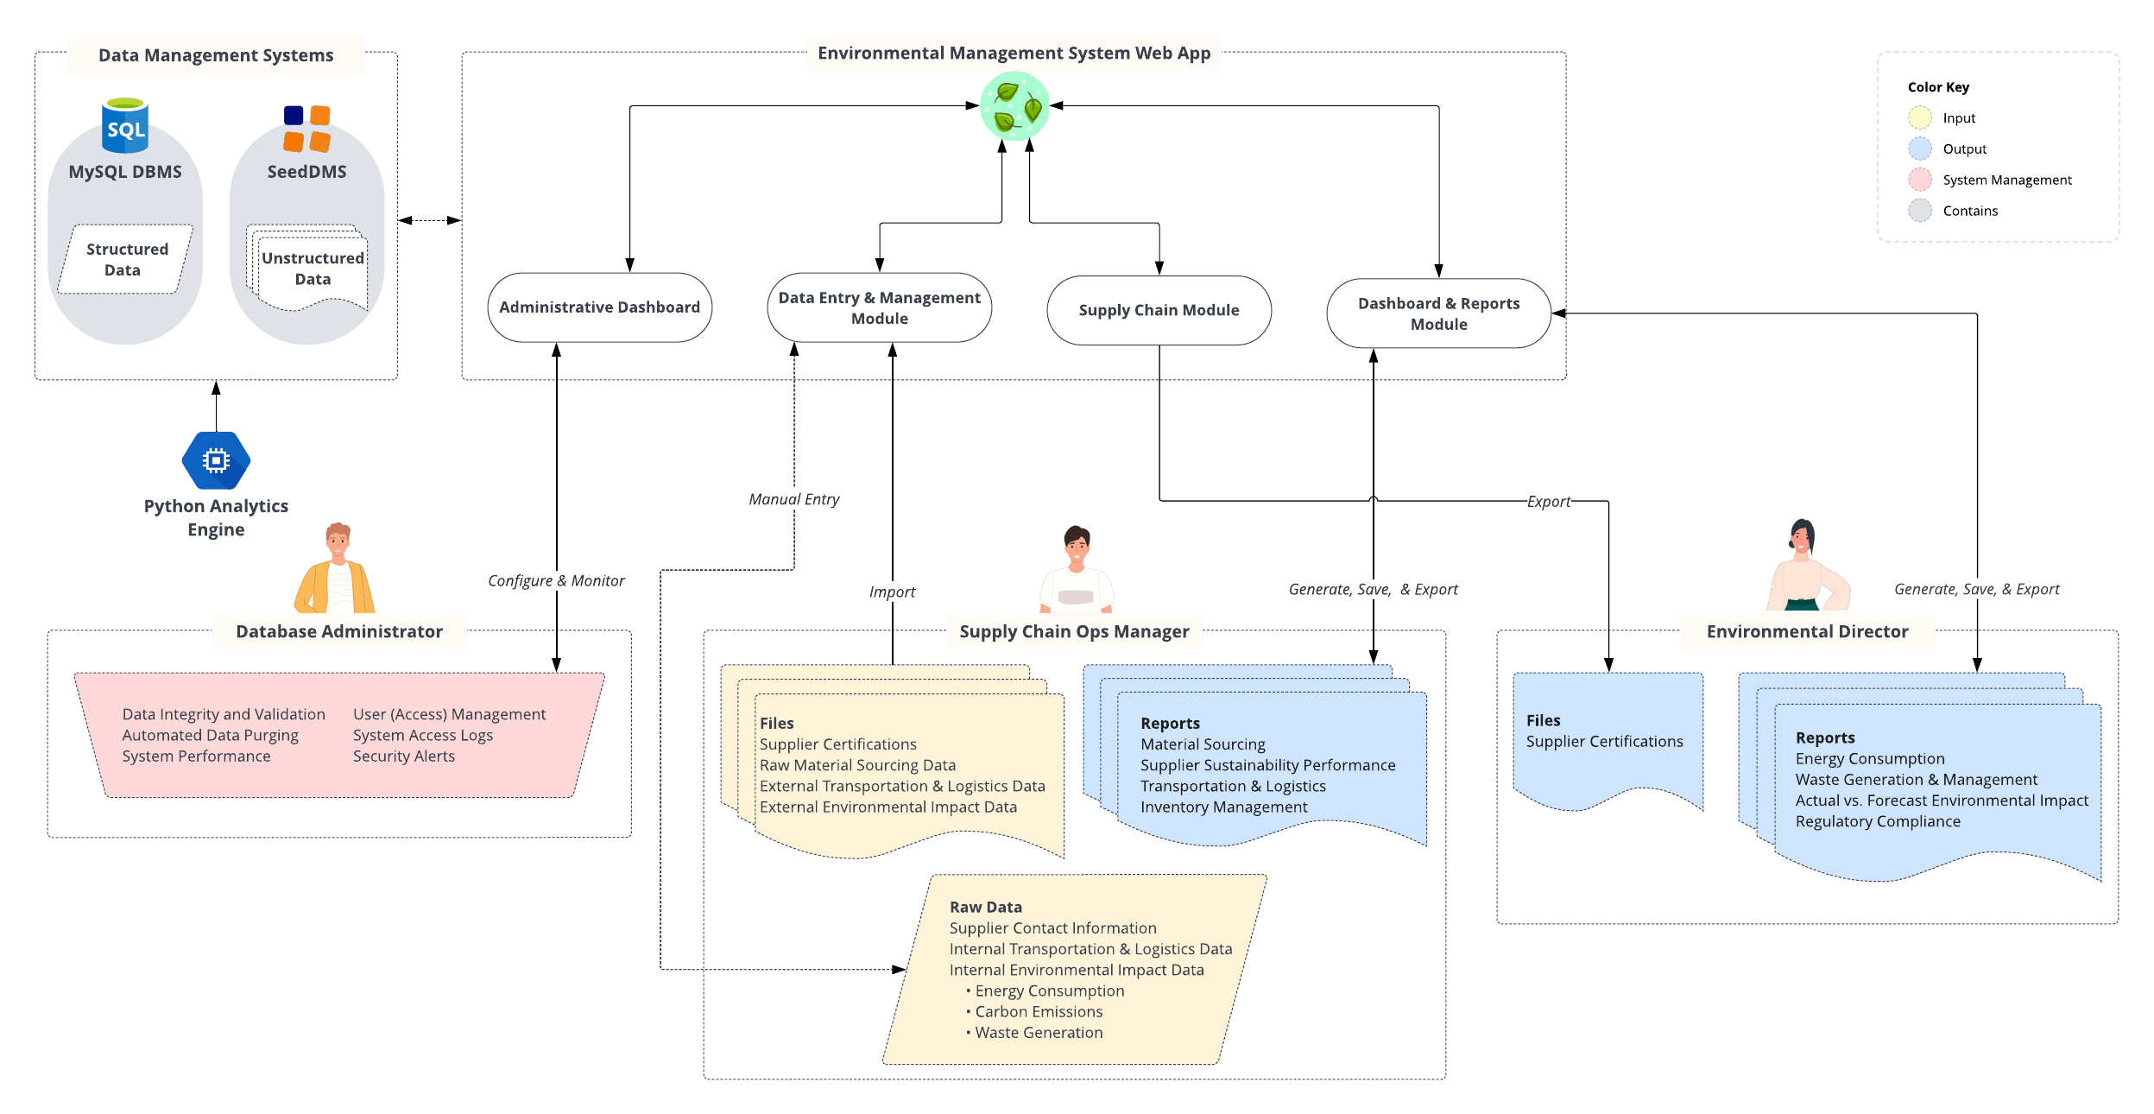
To-Be State
1
Administrative Dashboard
Database Administrator uses this to optimize performance and security of the EMS and data management systems.
Data Entry & Management and Supply Chain Module Supply Chain Ops Manager inputs and accesses the centralized data.
Dashboard & Reports Module Supply Chain Ops Manager and Environmental Director monitor environmental metrics and extract insights for data-driven decision making.
Icons used to create diagram from Lucid (https://lucid.co/)
[1] SeedDMS. (n.d.) SeedDMS Logo. Retrieved from https://www.seeddms.org/images/seeddms-logo.svg

Slide 5
To-Be State
1
Risk Mitigation
Data Breach^{2:} Strict access controls, robust encryption protocols to safeguard sensitive data, regular security audits and vulnerability assessments, user education on data security.
Data Loss³: Conduct regular backups, test backup and recovery processes for data integrity.
Administrative Dashboard
Database Administrator uses this to optimize performance and security of the EMS and data management systems.
Data Entry & Management and Supply Chain Module Supply Chain Ops Manager inputs and accesses the centralized data.
Dashboard & Reports Module Supply Chain Ops Manager and Environmental Director monitor environmental metrics and extract insights for data-driven decision making.
Icons used to create diagram from Lucid (https://lucid.co/)
[1] SeedDMS. (n.d.) SeedDMS Logo. Retrieved from https://www.seeddms.org/images/seeddms-logo.svg
[2]. IBM. (n.d.). Data Breach. Retrieved from https://www.ibm.com/topics/data-breach
[3]. Wikipedia. (2024, Apr 14). Data loss. In Wikipedia. Retrieved from https://en.wikipedia.org/wiki/Data_loss

Slide 6

Scrum¹-Incremental²: Sequential Increments
Increment 1 System Setup & Core Development
Increment 2 Advanced Data Management & User System
Increment 3 Data Visualization & Reporting
Increment 4 Security Enhancements
Increment 5 Compliance and Final Enhancements
Result
Allow user input and access to data through a secure system for data-driven decision-making.
Finish-Start Dependency
Result
Enhanced data management UI and robust user management for increased productivity.
Result
Gain visual insights from dashboards, facilitating proactive environmental management actions.
Result
Ensure data integrity and confidentiality, strengthening system security.
Result
Achieve environmental KPI targets with regulatory compliance and operational excellence
[1] Sean, P. (2023, Dec 30). What Is Agile Scrum Methodology? Retrieved from https://www.businessnewsdaily.com/4987-what-is-agile-scrum-methodology.html
[2] Martin, M. (2023, Dec 30). What is Incremental Model in SDLC? Advantages & Disadvantages. Retrieved from https://www.guru99.com/what-is-incremental-model-in-sdlc-advantages-disadvantages.html

Slide 7

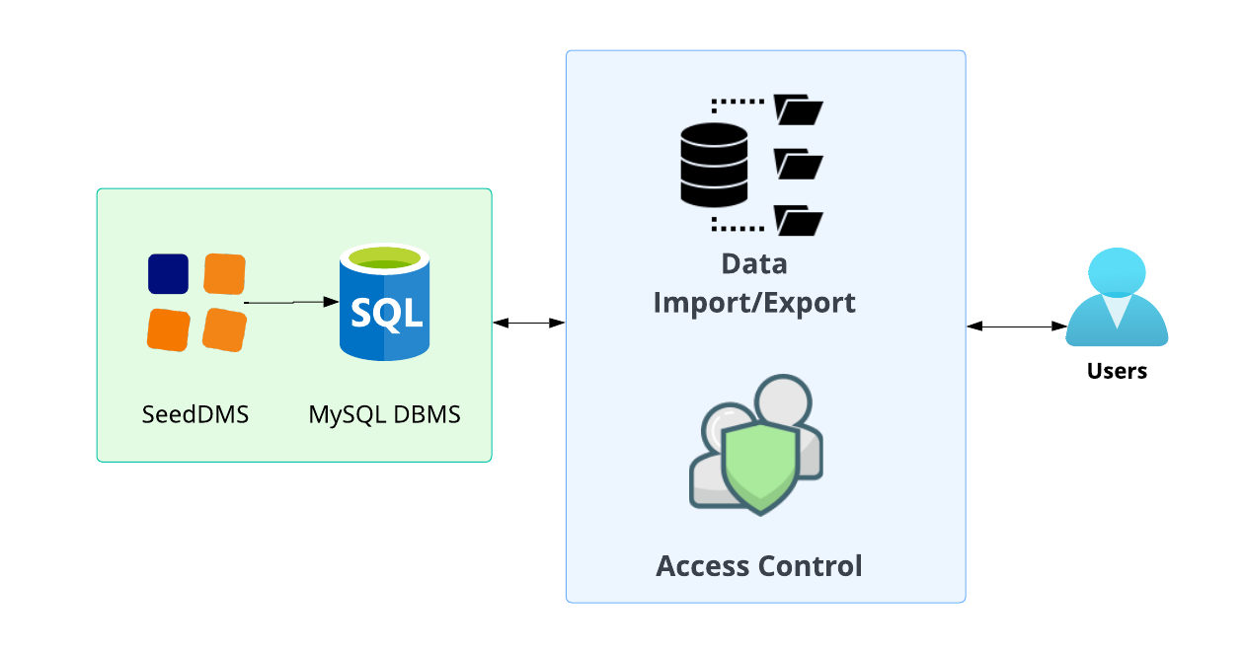
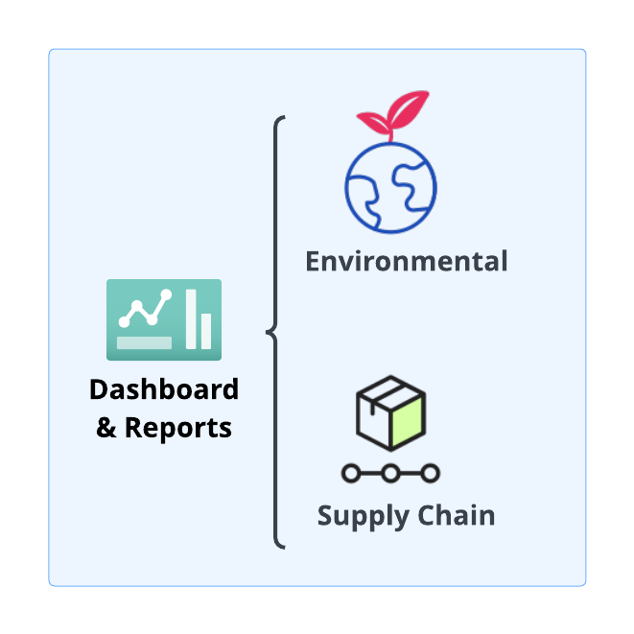
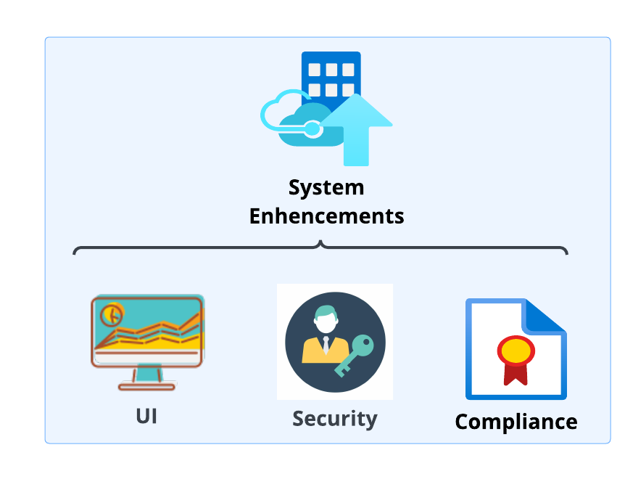
Release Roadmap
Timeline | June | July | August | September | October | November
Sprints | 1 | 2 | 3 | 4 | 5 | 6 | 7 | 8 | 9
Increments | 1 |  | 2 |  | 3 |  | 4 |  | 5
Releases | Version 1.0.0 08/21/2024 Alpha Release |  |  |  | Version 1.1.0 09/30/2024 Beta Release |  | Version 1.2.0 11/30/2024 Final Release
Milestones | System Foundation Data migration to MySQL database. Basic and enhanced data management. Advanced user management and data import/export. Secure user authentication and access control. |  |  |  | Basic Functionality Interactive reporting and dashboards tools. Real-time data updates with filtering. |  | System Enhancement Advanced data encryption and security. Compliance with regulatory requirements. Final refinements for user feedback.
Deliverables
MVP
Deliver the basic yet critical functionalities that enable users to start using the system for essential operations
Icons used to create diagram from Lucid (https://lucid.co/)​

Slide 8
ROI & ROV
Return on Investment
Return on Value
After the successful completion of this project, we will be able to reassign three team members to another project: two Data Entry Clerks and one Junior Sustainability Analyst
With an ROI of 40.14%, the project generates more in benefits than its costs within the first year, making it a profitable investment
Sustainability Performance: Saves $20K/year through efficiency and $10K/year from eco-products, totaling $30K/year benefits
Brand Differentiation: Emphasizing sustainability can grow customer base by 3%
Productivity Increase: Smart tech boosts productivity by
5-15% across roles
Regulatory Advantage: Improved EGS Reporting yields up to $20K/year savings
[1] UBQ Editorial Team. (2023, Nov 7). Sustainability in Manufacturing Processes. Retrieved from https://www.ubqmaterials.com/blog-post/sustainability-in-manufacturing-processes/
[2] Automation.com. (2020, Dec 3). Impacting Energy Through Smart Manufacturing. Retrieved from https://www.automation.com/en-us/articles/december-2020/impacting-energy-through-smart-manufacturing
[3] Strategy+Business. (2022, Dec 1). Green taxes and incentives can help businesses achieve ESG goals. Retrieved from https://www.strategy-business.com/article/Green-taxes-and-incentives-can-help-businesses-achieve-ESG-goals

Slide 9

Thank You

Slide 10
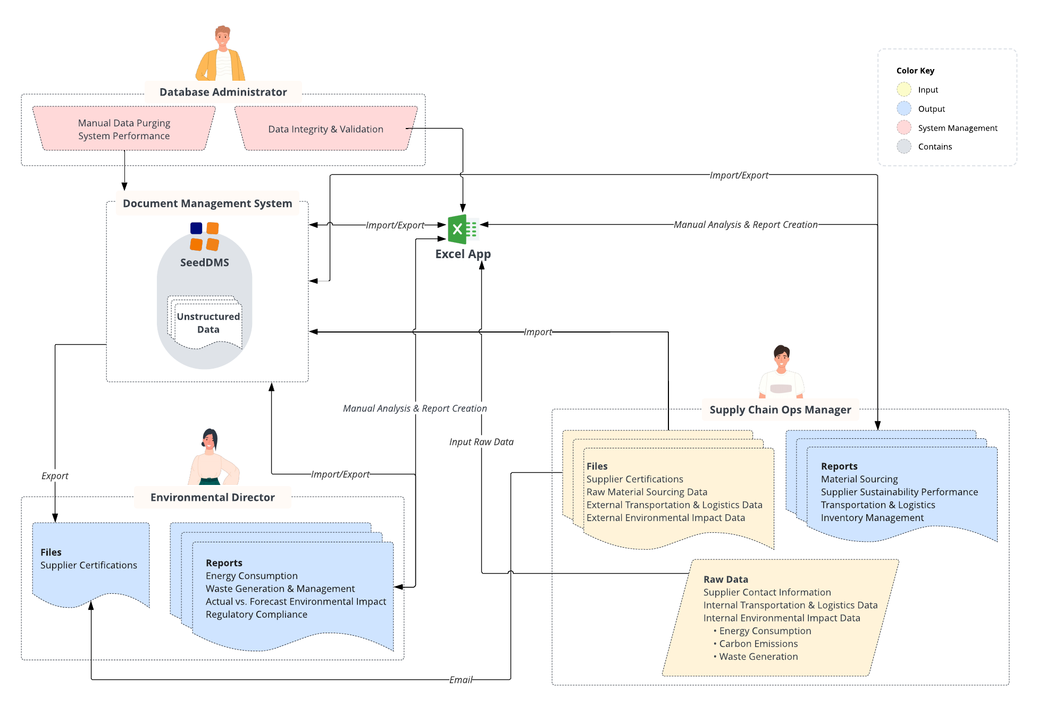
AVERAGE
As-Is State
Icons used to create diagram from Lucid (https://lucid.co/)
[1] SeedDMS. (n.d.) SeedDMS Logo. Retrieved from https://www.seeddms.org/images/seeddms-logo.svg

Slide 11
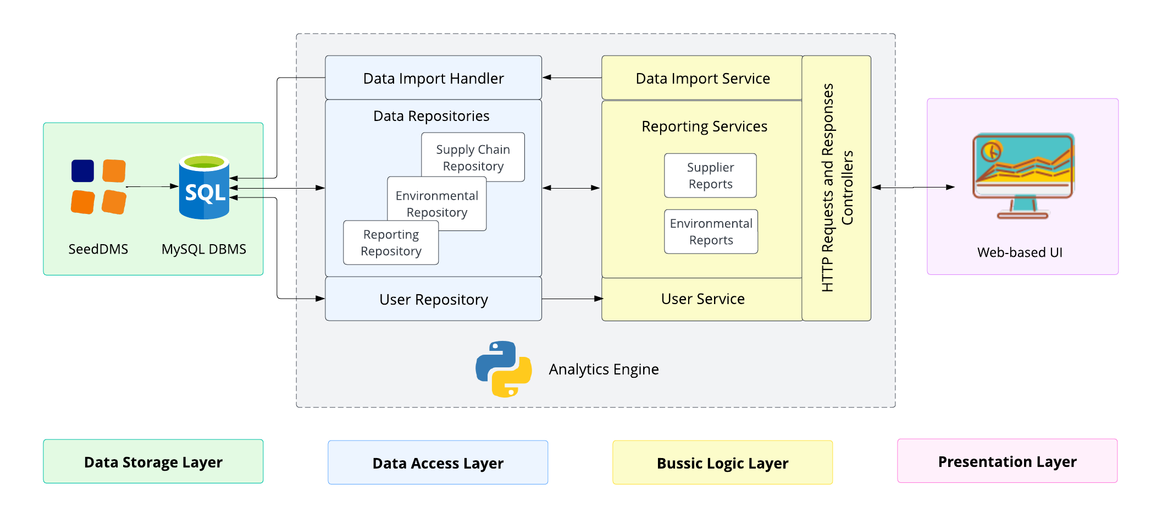
Layered Architecture
SIMPLE
Icons used to create diagram from Lucid (https://lucid.co/)

Slide 12
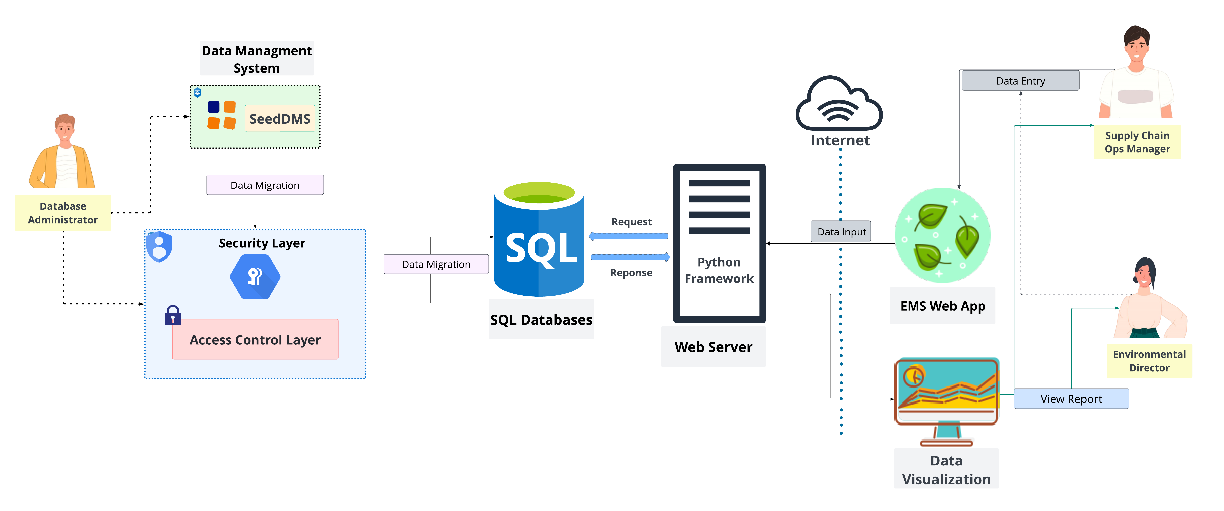
High Level Architecture
AVERAGE
Icons used to create diagram from Lucid (https://lucid.co/)

Slide 13
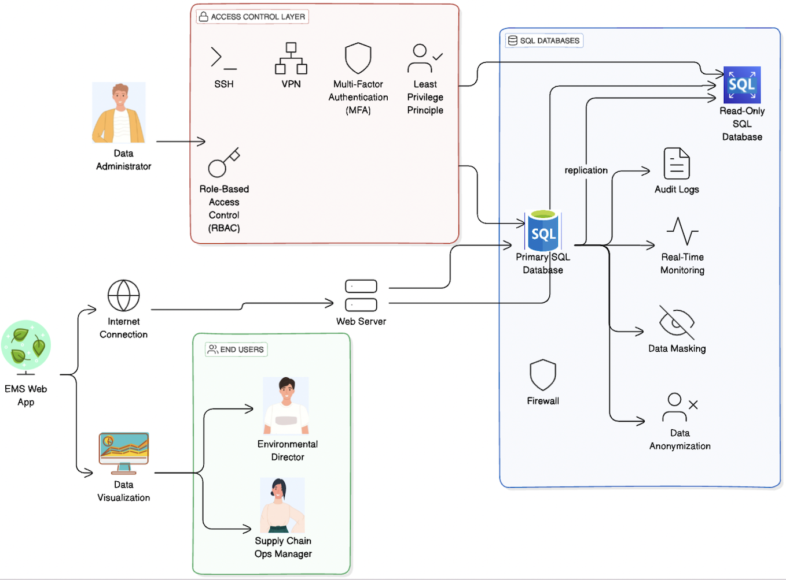
Low Level Architecture
AVERAGE
Icons used to create diagram from Lucid (https://lucid.co/) , Diagram flow from https://www.eraser.io/

Slide 14
Change Management Plan
SIMPLE
Preparation: The IT Team will create an FAQ document and high-level deck with an overview of the project, outline benefits of the new system, and provide a project timeline.
Communication & Awareness: Employees will be informed about the project via email (attaching the FAQ document and high-level deck) and managers will be instructed to inform their teams. IT leaders will be readily available to answer questions from teams; individual contributors should consolidate their inquiries to their managers to streamline communication.
Data Migration & System Integration: IT will collaborate with SeedDMS and MySQL administrators to establish secure integration protocols and conduct through testing to ensure data integrity and functionality after migration. If there is any potential loss of access to SeedDMS during data migration and system integration, employees will be notified in advance to export any documents prior to the scheduled activities.
System Training & Support: A live training session will be offered by the IT team to train employees and admin users on how to use the EMS; the session will be recorded and available for employees who are unable to attend. Additionally, the IT team will provide video tutorials and guides on how to navigate the EMS and explain the capabilities of the Dashboards & Reports Module. The IT team will intake feedback and questions throughout the process and create and share additional documentation as needed.
System Rollout: When the EMS is deployed organization-wide, the IT team will provide continuous support and welcome feedback. As new updates or future functionalities to the EMS become available, the IT team will develop standardized communication templates and a communication plan to inform employees.

Slide 15
ROI & ROV
Return on Investment
Return on Value
After the successful completion of this project, we will be able to reassign three team members to another project: two Data Entry Clerks and one Junior Sustainability Analyst.
With an ROI of 40.14%, the project generates more in benefits than its costs within the first year, making it a profitable investment.
Sustainability Performance: Enhancing sustainability can save up to $20,000 annually through energy efficiency and optimized resource use, with an additional $10,000 revenue increase from eco-friendly products, totaling $30,000 in benefits per year.
Brand Differentiation: Emphasizing sustainability helps distinguish the company in a competitive market, potentially increasing the customer base by an additional 3% due to growing consumer preference for eco-friendly products.
Productivity Increase: Implementing smart manufacturing technologies could lead to productivity gains between 5% and 15% for various managerial roles through enhanced data access, decision-making, and logistics optimization.
Regulatory Advantage: Compliance with environmental regulations can offer financial incentives like tax credits or reduced fees, possibly adding up to $20,000 in annual savings.
[1] UBQ Editorial Team. (2023, Nov 7). Sustainability in Manufacturing Processes. Retrieved from https://www.ubqmaterials.com/blog-post/sustainability-in-manufacturing-processes/
[2] Automation.com. (2020, Dec 3). Impacting Energy Through Smart Manufacturing. Retrieved from https://www.automation.com/en-us/articles/december-2020/impacting-energy-through-smart-manufacturing
[3] Strategy+Business. (2022, Dec 1). Green taxes and incentives can help businesses achieve ESG goals. Retrieved from https://www.strategy-business.com/article/Green-taxes-and-incentives-can-help-businesses-achieve-ESG-goals

Slide 16
SIMPLE
Risk Management¹
Type | Priority | Risk | Likelihood | Impact | Mitigation
Technical² | 1 | Challenges in data migration from Excel to MySQL | High | Data inconsistency, and disruption of business operations | Develop a detailed migration plan, utilize MySQL Workbench Migration Wizard, and collaborate with stakeholders
 | 2 | Potential security vulnerabilities within the new system | High | Data breaches and compromised system integrity | Conduct security assessments, implement access controls and encryption, and engage with cybersecurity experts for testing
 | 3 | Insufficient validation leading to inaccurate data | Medium | Compromised data integrity and erroneous decisions | Implement data validation protocols, provide training on data entry best practices, and establish data quality standards
Project Management | 1 | Scope creep to extended timelines and increased costs | High | Delayed project delivery, budget overrun | Define clear project scope, establish change control process, and regularly communicate with stakeholders
 | 2 | Underestimation of time and resources needed for tasks | Medium | Missed deadlines, resource shortages | Conduct thorough project planning, involve team in estimation, and regularly monitor and adjust project schedule
[1]. Wikipedia. (2024, Apr 14). Risk management. In Wikipedia. Retrieved from https://en.wikipedia.org/wiki/Risk_management
[2]. Nasa. Technical Risk Management. Retrieved from https://www.nasa.gov/reference/6-4-technical-risk-management/

Slide 17
Risk Management
SIMPLE
Type | Priority | Risk | Likelihood | Impact | Mitigation
Regulatory and Compliance | 1 | Non-compliance with data protection laws | High | Fines, penalties, reputational damage | Ensure system compliance with regulations, implement strong data protection, conduct regular audits, and provide staff training
 | 2 | Future changes in regulations that the system not handle | Medium | Fines, penalties, legal issues | Monitor regulatory changes, maintain flexibility in system design, conduct regular compliance audits, engage legal counsel for advice
Organizational | 1 | Resistance to change from employees leading less adoption | High | Reduced productivity, project failure | Communicate the benefits of the change, involve employees in the process, provide training and support, address concerns
 | 2 | Loss of key project personnel can lead to knowledge gaps | Medium | Disruption of project continuity, loss of expertise | Cross-train team members, document processes and knowledge, develop succession plans, incentivize retention
 | 3 | Insufficient training for users of the new system | Medium | Low user adoption, decreased efficiency | Develop comprehensive training programs, provide ongoing support and resources, gather user feedback for continuous improvement

Slide 18
Return on Investment (ROI)
SIMPLE
Assumptions
Employee Salaries²
Software Developer: $80,000
Data Architect : $70,000
DevOps Engineer : $70,000
QA Tester : $65,000
Junior Sustainability Analyst: $110,000
Data Entry Clerk : $55,000
Burden Rate: 25%
Saving from Penalty: $20,000
Hardware and Network Equipment* Cost: $8,000
*Servers, Cabling, and Installation
Training and Implementation: $30,000
Given
Project Duration: 6 Months
4 Software Team Members: SW Developer, Data Architect, DevOps Engineer, QA Tester
Average Monthly Salary: $23,000
Total Salary for 6 Months: $138,000
Total Salary including Burden Rate: $172,500
Total Investment Cost: $210,500
After the project, 3 resources can be moved to other projects (2 Data Entry Clerk, Junior Sustainability Analyst)
Salary of 2 Data Entry Clerk and Junior Sustainability Analyst include Burden Rate: $275,000
Total Benefits: $295,000
Calculating ROI For 1st Year
ROI =
ROI =
ROI = 40.14 %
Project yields more in benefits than it costs within the first year, indicating a profitable investment. Qualitative benefits contribute significantly to the long-term value and sustainability.
( )
Total Benefits – Total Costs
Total Cost
* 100
( )
295,000 – 210,500
210,500
* 100
[1] Ethixbase360. (2023, Nov 10). Beyond the Numbers: Corporate ESG Spending Gains Momentum Amid Calls for Transparency. Retrieved from https://ethixbase360.com/beyond-the-numbers-corporate-esg-spending-gains-momentum-amid-calls-for-transparency/
[2] ZipRecruiter. (n.d.). Salaries. Retrieved from https://www.ziprecruiter.com/Salaries

Slide 19
Return on Value (ROV)
SIMPLE
Value Factor | Description & Calculation
Sustainability Performance | Improving sustainability metrics can save $20,000 annually through reduced energy consumption, waste management, and optimized raw materials. Revenue can increase by $10,000 yearly from eco-friendly products boost and marketing advantages, resulting in a total benefit of $30,000 annually.
Brand Differentiation | By leading in sustainability, the company distinguishes itself in a competitive market. This enhances brand loyalty and attracts new customers who prioritize eco-friendly products. Estimating an additional 3% increase in customer base.¹
Productivity Increase | We target productivity increase from 5% - 15%² Environmental Managers: Expect 4% increment through faster data access and automated reporting for improved analysis and collaboration. Operations Managers: Data-driven decision-making, process optimization, and efficient resource allocation to achieve 6% - 10% productivity increase. Supply Chain Managers: Supplier performance monitoring, risk management, and cost savings through optimized logistics realize a 5% gain.
Regulatory Advantage | Proactive compliance leads to preferential treatment under certain regulations, grants, or tax benefits. Estimating a financial impact (i.e., green tax credit or reduced fees) of approximately $20,000 in annual savings.³
[1] UBQ Editorial Team. (2023, Nov 7). Sustainability in Manufacturing Processes. Retrieved from https://www.ubqmaterials.com/blog-post/sustainability-in-manufacturing-processes/
[2] Automation.com. (2020, Dec 3). Impacting Energy Through Smart Manufacturing. Retrieved from https://www.automation.com/en-us/articles/december-2020/impacting-energy-through-smart-manufacturing
[3] Strategy+Business. (2022, Dec 1). Green taxes and incentives can help businesses achieve ESG goals. Retrieved from https://www.strategy-business.com/article/Green-taxes-and-incentives-can-help-businesses-achieve-ESG-goals

Slide 20
DBMS Decision Criteria
SIMPLE
As an environmentally conscious company, Eco-Friendly Furniture Co. requires a DBMS that not only supports our operational needs but also aligns with our sustainability ethos and data management requirements.
Criteria Definition & Weight Assignment
Cost Efficiency (Weight 20%): Reflects our commitment to cost-effectiveness and resource optimization. A rating of 5 indicates no unnecessary financial expenditure.​
Operational Performance (Weight 25%): Critical for managing large datasets of environmental impact. A DBMS that perfectly meets our performance expectations scores a 5.​
Usability & Management (Weight 15%): Our system should be user-friendly, reflecting our collaborative and inclusive work culture. A score of 5 suggests the system is exceptionally easy to use.​
System Flexibility (Weight 10%): Represents the need for our DBMS to adapt to evolving environmental data types and sources. A score of 5 means the system is highly adaptable.​
Data Security (Weight 20%): Security is paramount due to the sensitivity of environmental data. A rating of 5 indicates robust security features in line with best practices.​
Community Support (Weight 10%): An active OSS community offers long-term sustainability for our EMS, with a score of 5 indicating excellent support and community engagement.​
Rating Scale
Each OSS is evaluated against these criteria on a 1-5 scale.
A score of 5 signifies perfect alignment with the business objective related to that criterion.
[1] Andrea,O. (2018 Jan 29). 8 Key Considerations When Choosing a DBMS. Retrieved from https://blog.paessler.com/key-considerations-when-choosing-a-dbms
[2] Dallas TX.(2023, Sep 6). Choosing the Right Database Management System for Your Application. Retrieved from https://axissoftwaredynamics.com/choosing-the-right-database-management-system-for-your-application/

Slide 21
DBMS Competitive Analysis
SIMPLE
Criteria | MySQL¹ |  | PostgreSQL^{1, 2} |  | SQLite¹
 | Description | Score | Description | Score | Description | Score
Cost Efficiency | Free, open-source | 4 | Free, open-source | 3 | Free, open-source | 5
Operational Performance | High performance, especially for read-heavy workloads | 5 | Excellent performance, particularly for complex queries and write-intensive workloads | 4 | Good performance for small-scale and embedded applications | 3
Usability & Management | Easy to install, configure, and manage | 4 | Slightly more complex setup, but offers extensive features and control | 3 | Very easy to use and manage, particularly for small-scale projects | 4
System Flexibility | Supports various storage engines and replication methods | 5 | Advanced features (i.e., complex data types, full-text search) | 5 | Lightweight and suitable for embedded use cases, but lacks some advanced features | 3
Data Security | Provides robust security features (i.e., access controls, encryption options) | 5 | Strong security features, including role-based access control and SSL support | 4 | Limited security features compared to server-based databases | 3
Community Support | Large and active community | 4 | Large and active community | 5 | Active community, particularly for embedded use cases | 4
Total Score | 27 |  | 24 |  | 22
[1] Devathon Team. (2021, Jan 15). MySQL vs PostgreSQL vs SQLite. (n.d.). Devathon. Retrieved from https://devathon.com/blog/mysql-vs-postgresql-vs-sqlite/
[2] Drake, M & ostezer. (2022, Mar 9). "SQLite vs MySQL vs PostgreSQL: A Comparison of Relational Database Management Systems." (n.d.). DigitalOcean. Retrieved from https://www.digitalocean.com/community/tutorials/sqlite-vs-mysql-vs-postgresql-a-comparison-of-relational-database-management-systems

Slide 22
MySQL Overview
SIMPLE
MySQL is the world’s most popular¹ open-source client/server relational database management system developed and maintained by Oracle’s MySQL team. As an open-source software, it is available for use under the version two GNU General Public License².
Sponsors
MySQL has 8,000+ sponsors³, with the most sponsors at Hewlett Packard Enterprise, Amazon Web Services, Microsoft, and VMware.
Critical Users
MySQL is used by major companies including Facebook, Twitter, eBay, Pinterest, Tumblr, Wikipedia, and many more⁴.
Key Benefits⁵
Ease of use
Reliability
Scalability
Performance
High Availability
Security
[1] MySQL. (n.d.). About MySQL. Retrieved from https://www.mysql.com/about/
[2] MySQL. (2010, Jul). Commercial License for OEMs, ISVs and VARs. Retrieved from https://www.mysql.com/about/legal/licensing/oem/
[3] PartnerBase. (n.d.). MySQL. Retrieved from https://www.partnerbase.com/mysql
[4] Oracle. (n.d.). MySQL. Retrieved from https://www.oracle.com/webfolder/college-recruiting/projects/mysql.html
[5] Oracle. (n.d.). What is MySQL?. MySQL. Retrieved from https://www.oracle.com/mysql/what-is-mysql/

Slide 23

MySQL Upstream & Downstream
SIMPLE
Upstream²
Distribution³
Downstream¹
The official MySQL codebase maintained by the MySQL development team at Oracle Corporation.
MySQL has several distributions for various use cases and deployment scenarios:
MySQL Community Edition
MySQL Enterprise Edition
MySQL Cluster
MySQL Database Service MySQL HeatWave
MySQL's downstream versions are derived versions or branches based on the upstream MySQL versions, with modifications, optimizations, or extensions:
MariaDB
Percona Server for MySQL Amazon RDS MySQL
[1] DB-Engines GmbH. (n.d.). System Properties Comparison Amazon Aurora vs. MariaDB vs. Percona Server for MySQL. Retrieved from https://db-engines.com/en/system/Amazon+Aurora%3BMariaDB%3BPercona+Server+for+MySQL
[2] Oracle Corporation. (2024 Apr 8). MySQL logo. Retrieved from https://1000logos.net/mysql-logo/
[3] MySQL. (n.d.). Retrieved from https://www.mysql.com/

Slide 24


MySQL User Success Stories
SIMPLE
"MySQL is the engine that drives our business, handles computationally intensive queries, and performs all the testing in terms of executing tasks and producing valuable results for users. It's the engine that drives QuerySurge.“¹
Joe Brandsdorfer
Director of Operations, Real-Time Tech Solutions
"The decision to use MySQL’s built-in replication to migrate the data for us meant that we no longer had to build the most challenging pieces to guarantee data consistency ourselves as replication was a proven quantity.“²
Willie Yao
Head of Developer Infrastructure
[1] MySQL. (n.d.). RTTS Uses MySQL Embedded for QA and Testing Platform. Retrieved from https://www.mysql.com/why-mysql/case-studies/rtts-querysurge-mysql-embedded.html
[2] Yao, W. (2015, Oct 6). How We Partitioned Airbnb’s Main Database in Two Weeks. Retrieved from https://medium.com/airbnb-engineering/how-we-partitioned-airbnb-s-main-database-in-two-weeks-55f7e006ff21

Slide 25
OSS Guiding Principles¹
SIMPLE
License Compliance We must understand and adhere to the open-source license terms.
Community Engagement We should actively participate and contribute to the open-source community.
Transparency and Collaboration We need to be transparent about our software use and collaborate openly.
Security and Quality Assurance We must prioritize security and conduct thorough testing.
Long-Term Maintenance We should consider sustainability and community support for long-term use.
[1] Open Source Software. (2024, Jan 6). Free and Open Source Software (FOSS) Core Principles. Retrieved from https://osssoftware.org/blog/free-and-open-source-software-foss-core-principles/

Slide 26
SDLC Model Scrum + Incremental Model
SIMPLE
Benefits of Scrum¹
Benefits of Incremental Model²
Flexibility and Adaptivity: Scrum is highly adaptive to changes, which is crucial in projects dealing with environmental data. In such area, requirements can evolve frequently because of new regulations or changes in company policy. Based on ongoing feedback, priorities and functionalities could be adjusted on account of Scrum’s iterative process. Stakeholder Engagement: Stakeholders are involved throughout the development process by means of regular reviews and sprints in Scrum. This continuous engagement is crucial for our EMS, because it aligns with user needs and compliance requirements. Team Dynamics and Productivity: Scrum enhance collaboration and self-organizing within the team, which can facilitate problem-solving and innovation. Regular sprints and stand-up meetings keep teams focused and productive. | Progressive Development: The Incremental model provides manageable, functional or increments modules in the development of our EMS. This method breaks down the development process into smaller parts, each adding functionality to the previously delivered parts, and it is ideal for complex projects. Early and Predictable Deliveries: By delivering the system incrementally, we'll able to provide functional improvements at each stage, which enables early testing and feedback. This is essential for an EMS, where early bug detection and adaptation to user feedback can significantly enhance the final product. Risk Management: This model reduces risks, because each increment is smaller and more manageable. Problems can be detected early and are typically associated with a specific increment. This will make them easy to address without affecting the entire system.
[1] Sean, P. (2023, Dec 30). What Is Agile Scrum Methodology? Retrieved from https://www.businessnewsdaily.com/4987-what-is-agile-scrum-methodology.html
[2] Martin, M. (2023, Dec 30). What is Incremental Model in SDLC? Advantages & Disadvantages. Retrieved from https://www.guru99.com/what-is-incremental-model-in-sdlc-advantages-disadvantages.html

Slide 27
Why a Blend of Scrum and Incremental Model?^{1, 2}
SIMPLE
Combining Predictability with Flexibility: Blending the Incremental Model with Scrum provides the structured delivery of increments. In the meanwhile, it will still maintain the flexibility based on real-time feedback and changing needs. This is particularly useful for an EMS, where different modules might require rapid adjustments due to technological, regulatory, or operational changes.
Enhanced Focus on Deliverables: Incremental Model’s focus on delivering working components at each stage. While combined with Scrum’s sprint-based approach, each component will be fully functional and meet quality standards before moving on to the next. This method reduces the accumulated complexity, especially during the final stages of the project.
Risk Reduction: The regular review and adaptation processes in Scrum, associated with the Incremental Model’s approach to modular development, will effectively spread the risk. Each increment can be adjusted or improved without significant disturbing the entire project, which is crucial in managing risks while developing an EMS.
Continuous Improvement and Integration: With each increment, the team can integrate lessons learned into the next phase. This continuous loop of feedback and improvement will provide robustness, user-friendliness, and compliance with environmental standards in our EMS.
[1] Sean, P. (2023, Dec 30). What Is Agile Scrum Methodology? Retrieved from https://www.businessnewsdaily.com/4987-what-is-agile-scrum-methodology.html
[2] Martin, M. (2023, Dec 30). What is Incremental Model in SDLC? Advantages & Disadvantages. Retrieved from https://www.guru99.com/what-is-incremental-model-in-sdlc-advantages-disadvantages.html

Slide 28
Sprint Plan
AVERAGE
Sprint 1
Objective: System Setup Required Task:
Set up project environment.
Integrate with SeedDMS.
Develop basic data management functionalities. Success Criteria:
Project environment is set up and accessible to the team.
Basic data management functionalities are operational.
Sprint 2
Objective: Development Required Task:
Establish user authentication and basic access controls.
Users can input and access environmental data securely.
Implement real-time updates of current month's energy consumption, carbon emissions, and waste generation (User Story 1.0). Success Criteria:
User authentication and access controls are established and verified.
Users can input and access environmental data securely.
Real-time updates are functional and accurate.
Increment 1
System Setup & Core Development
Sprint 3
Objective: Advanced Data Management Required Task:
Enhance data import and export capabilities.
Develop Reports Dashboard for report templates, customization, and export (User Story 1.1). Success Criteria:
Enhanced data import/export functions are tested and working.
Reports Dashboard is operational with required features.
Sprint 4
Objective: User System Required Task:
Expand user management features.
Implement more sophisticated access controls.
Implement analytics in Dashboard & Reports Module for data filtering and comprehensive analysis (User Story 1.2, 2.3).
Robust user management system is operational, increasing engagement and productivity.
Success Criteria:
User management features are expanded and validated.
Sophisticated access controls are implemented and functional.
Analytics features operational with filtering and analysis tools.
Robust user management system is operational, increasing engagement and productivity.
Increment 2
Advanced Data Management & User System
[1] Eby, K. (2022, Sep 29). Sprint planning templates. Smartsheet. Retrieved from https://www.smartsheet.com/content/sprint-planning-templates

Slide 29
AVERAGE
Sprint 5
Objective: Supply Chain and Data Entry Required Task:
Develop Supply Chain Module (User Story 1.3, 2.2).
Develop Data Entry Module for manual data entry and CSV/Excel import (User Story 2.0). Success Criteria:
Supply Chain Module is functional.
Data Entry Module is tested and operational.
Sprint 6
Objective: Data Visualization Required Task:
Develop initial dashboards and reporting tools.
Integrate real-time data updates and filtering capabilities Success Criteria:
Initial dashboards and reporting tools are developed and reviewed.
Real-time data updates and filtering capabilities are integrated and tested.
Increment 3
Data Visualization and Reporting
Sprint 7
Objective: Reporting Element Required Task:
Integrate more robust user management (Increment 2 continuation).
Enhanced UI for data import/export functions is deployed.
Robust user management system is operational, increasing engagement and productivity. Success Criteria:
Enhanced UI for data import/export functions is deployed.
Robust user management system is operational, increasing engagement and productivity.
Sprint 8
Objective: Security Enhancements Required Task:
Implement robust data encryption and security measures.
Predictive analysis and anomaly detection are operational.
Sensitive data is encrypted and secure, ensuring trust and compliance. Success Criteria:
Data encryption and security measures are implemented and verified.
Predictive analysis and anomaly detection are operational.
Sensitive data is encrypted and secure, ensuring trust and compliance.
Increment 4
Security & UI Enhancements
Sprint 9
Objective: Compliance and Final Enhancements Required Task:
Ensure all compliance requirements are met.
Conduct final testing and adjustments based on stakeholder feedback.
Project is ready for final delivery and meets all defined KPIs.
Achieve full regulatory compliance and operational excellence.
Success Criteria:
All compliance requirements are reviewed and met.
Final testing is completed, and adjustments are made based on feedback.
Project is ready for final delivery and meets all defined KPIs.
Achieve full regulatory compliance and operational excellence.
Increment 5
Compliance & Final Enhancements
[1] Eby, K. (2022, Sep 29). Sprint planning templates. Smartsheet. Retrieved from https://www.smartsheet.com/content/sprint-planning-templates

Slide 30



Personas
TITLE
Pam
Environmental Director
Jim
Supply Chain Ops Manager
Oscar
Database Administrator
[1] svstudioart. (n.d.). Banner with diverse happy people group standing together on white [Image]. Freepik. Retrieved from https://www.freepik.com/free-vector/banner-with-diverse-happy-people-group-standing-together-white_12873006.htm#fromView=search&page=1&position=27&uuid=f789654e-d293-4c2f-adc9-d60109001927

Slide 31

SIMPLE
Pam: Environmental Director
Characteristics: results-oriented, expertise in environmental best practices, deeply engaged in the local environmental community, strategic visionary, goal-oriented planner
Responsibilities
Develops, implements, and communicates the company‘s environmental sustainability strategy and goals to stakeholders.
Oversees environmental impact data collection, analysis, and reporting.
Manages relationships with San Francisco regulatory agencies and certification bodies and collects feedback to drive improvement.
Collaborates with Supply Chain Ops Manager to ensure supply chain operations are conducted in an environmentally-responsible manner in alignment with the company mission.
Pain Points
Difficulty locating, aggregating, and analyzing environmental data from SeedDMS due to lack of filtering and search functionalities which results in lack of visibility into environmental performance across the company.
Time-consuming manual data entry and manipulation in Excel.
As environmental impact reporting is being fed up the chain, there are version control issues where files become corrupted and data integrity is diminished due to multiple users modifying one file.
Repeated requests and long wait times to receive environmental performance reports from teams.
Requirements
Centralized system for collecting, storing, and analyzing environmental data.
Fast processing of large data volumes and protection against unauthorized changes.
Standardized reports and dashboards that updates based on environmental impact data in the system. The reports and dashboards must be interactive, shareable, and exportable.
Ability to generate and export reports for regulatory compliance and sustainability certifications.
[1] svstudioart. (n.d.). Banner with diverse happy people group standing together on white [Image]. Freepik. Retrieved from https://www.freepik.com/free-vector/banner-with-diverse-happy-people-group-standing-together-white_12873006.htm#fromView=search&page=1&position=27&uuid=f789654e-d293-4c2f-adc9-d60109001927
[2] San Francisco Department of the Environment. (n.d.). Business Resources. Retrieved from https://www.sfenvironment.org/business-resources

Slide 32

SIMPLE
Jim: Supply Chain Ops Manager
Characteristics: analytical mindset, detail-oriented, strategic planner, decision maker, environmental stewardship
Responsibilities
Manages supplier relationships; collects supplier sourcing, transportation, and logistics data and sustainability certifications to ensure adherence to sustainable sourcing practices.
Establishes supply chain transparency and traceability to track the origins of raw materials used in production.
In collaboration with the Environmental Director, monitors environmental impact resulting from supply chain operations to ensure alignment with internal environmental goals and compliance with regulations.
Pain Points
As data volume increases, supply chain transparency and traceability is difficult to manage, and regular reporting is a time-consuming, repetitive task on Excel.
Supplier information and sustainability certification is difficult to search and filter through.
Limited analytics capabilities to assess supply chain process efficiency and environmental performance using Excel.
Requirements
Centralized system to easily import data from suppliers and manually enter internal environmental impact data and ensure data consistency, accuracy and integrity.
System equipped with advanced analytics functionalities and the ability to easily repeat those analyses on the data I select.
Easy-to-use interface to generate customizable reports and dashboards; the ability to save and templatize reports and dashboards for future use.
Automated notifications if environmental metric thresholds are exceeded or anomalies are detected.
[1] svstudioart. (n.d.). Banner with diverse happy people group standing together on white [Image]. Freepik. Retrieved from https://www.freepik.com/free-vector/banner-with-diverse-happy-people-group-standing-together-white_12873006.htm#fromView=search&page=1&position=27&uuid=f789654e-d293-4c2f-adc9-d60109001927

Slide 33
SIMPLE
Oscar: Database Administrator
Characteristics: 5+ years of experience as a database administrator, excellent problem solver, security conscious, proactive planner, growth mindset
Responsibilities
Configures and maintains database management system for required updates and software patches.
Manages system security and implements access controls and security protocols.
Monitors system performance and troubleshoots technical issues.
Conducts regular data backups and disaster recovery planning.
Pain Points
Excel does not have robust security features, so data security and compliance has been difficult to manage across local drives and shared network folders.
File recovery in cases of accidental deletion, file corruption, and hardware failure is sometimes not possible due to the current lack of built-in backup and recovery mechanisms.
Lack of centralized data repository for environmental information makes data management time consuming.
Requirements
Database system with automated administrative tools for routine procedures to optimize system efficiency and monitoring.
Customizable security features for data encryption, user access controls, and security logs to protect confidential data and identify and mitigate potential risks.
APIs to integrate the database with other systems and third-party applications.
Comprehensive documentation and support resources to refer to for troubleshooting.
[1] svstudioart. (n.d.). Banner with diverse happy people group standing together on white [Image]. Freepik. Retrieved from https://www.freepik.com/free-vector/banner-with-diverse-happy-people-group-standing-together-white_12873006.htm#fromView=search&page=1&position=27&uuid=f789654e-d293-4c2f-adc9-d60109001927

Slide 34
Story Point Relative Sizing
SIMPLE
To apply relative sizing for each user story, we identified value factors and gave each criterion a weight from an empirical scale of 1-5. Based on the value factor weights, a user story can receive a maximum of 25 story points.
Value Factor | Description | Weight
Business Impact | Essential to core business operations, technical readiness, system setup, and core development. | 5
Strategic Importance | Aligns with mission, objectives, and delivers value to stakeholders (i.e., enables stakeholders to perform responsibilities effectively - data analysis, report and dashboard creation, system and monitoring). | 5
Implementation Complexity | Substantial technical development (i.e., re-design or new UI needed, algorithm development) and/or is a prerequisite for other components. | 3
Risk Mitigation | Necessary to mitigate or prevent risks (i.e., security safeguarding data loss or breach.) | 5
Regulatory Compliance | Essential for industry regulations and standards. | 4
Operational Efficiency | Optimizes system and operational efficiency, contributing to cost-saving benefits. | 3

Slide 35
Environmental Director User Stories
AVERAGE
ID | User Story | Acceptance Criteria | Story Points
★ 1.0 Epic | As Environmental Director, I want to create dashboards and reports using data integrated from the database management system to monitor environmental KPIs in a Dashboards & Reports Module of the EMS so that I can develop sustainability goals and ensure compliance with regulations. | EMS integration provides access to data from database management system (SeedDMS and MySQL DBMS) User can create new dashboards and reports using Dashboards & Reports Module Dashboards and reports are populated with the data the user selects | 20
1.1 | As Environmental Director, I want to export or share via link dashboards and reports from the Dashboards & Reports Module so that I can share them with stakeholders to verify our sustainability targets are met. | Dashboards and reports can be saved and accessed again in the EMS. Users can export a local copy of dashboards and reports. Local dashboard copies are not interactive. Shareable link allows users with EMS access to view dashboards and reports. | 15
1.2 | As Environmental Director, I want to export multiple supplier sustainability certification documents at a time from the Supply Chain Module so that I can quickly consolidate documents for regulation compliance. | Supplier sustainability documents appear in the Supply Chain Module. Multiple documents can be selected and exported at once. Export status message informs the user if the export is successful or failed. If failed, file(s) that failed to export are indicated. | 19

Slide 36
AVERAGE
Supply Chain Ops Manager User Stories
ID | User Story | Acceptance Criteria | Story Points
★ 2.0 Epic | As the Supply Chain Ops Manager, I want to access supply chain ops environmental impact data (supplier information, raw material sourcing, manufacturing processes, transportation and logistics, inventory) from the Supply Chain Module (a consolidated view of supply chain data) of a reliable EMS with a system uptime of at least 99.5% so that I can ensure supply chain operations are in alignment with environmental goals and compliant with regulations. | Data from all sources is accurately integrated and visualized within the Supply Chain Module without errors. The system processes and visualizes data within the stipulated time limits, ensuring efficient operations. The system uptime demonstrates reliability with at least 99.5% uptime, ensuring continuous operation. | 25
2.1 | As a Supply Chain Operations Manager, I need a system that generates detailed reports on material sourcing and supplier performance. These reports should include at least 95% of our active suppliers and cover key metrics like delivery time, cost compliance, quality of materials, and sustainability ratings, so that I can make well-informed decisions that enhance the cost-effectiveness and sustainability of our supply chain. | The system includes data from at least 95% of active suppliers in each generated report. The metrics on delivery time, cost compliance, and other factors are accurately calculated and displayed. Reports are easy to access, readable by the chain management team, and interpretable. The reports reflect the latest and most accurate data on supplier performance. | 25
2.2 | As a Supply Chain Operations Manager, I need a system to gather and analyze data on the environmental impacts of our operations, including CO2 emissions, energy consumption, recycling rates, and waste generation. This system should allow for the analysis of historical data spanning at least the past five years, enable quick processing and visualization of new data within 24 hours, and facilitate the generation of automated compliance reports monthly. The system must also include APIs that enable integration with other corporate systems and support the extraction of environmental data for detailed analysis and reporting, so that we can comply with environmental regulations and support our corporate sustainability goals. | The system correctly captures and analyzes specified environmental metrics and historical data. Data is processed and visualized within 24 hours, meeting visualization deadlines. Compliance reports are generated on schedule and adhere to regulatory standards. APIs demonstrate effective integration and robust data handling under operational conditions. | 22
2.3 | As a Supply Chain Operations Manager, I need a system that allows me to easily export data in multiple formats for detailed analysis and reporting. The system must support exporting data in at least three different file formats such as CSV, Excel, PDF, XML, and JSON. It should complete the export process within 5 minutes for reports up to 500 MB and allow for customization of the exported data based on user-selected parameters. The system should also maintain a log of all export activities, so that we can facilitate effective communication with both internal and external stakeholders, ensuring transparency and compliance. | The system supports data export in at least CSV, Excel, PDF, XML, and JSON formats. The data export process completes within 5 minutes for reports up to 500 MB. The system allows for customization of the exported data based on user-selected parameters. Export activities log accurately, maintaining detailed and compliant records of user and file size activities. | 20

Slide 37
AVERAGE
Database Administrator User Stories
ID | User Story | Acceptance Criteria | Story Point
★ 3.0 Epic | As Database Administrator, I want to have admin access to configure security protocols and manage system access in the Administrative Dashboard, so that I can ensure that the system and internal data is secure. | Only EMS admin users can access the Administrative Dashboard Admin user can configure and implement security protocols to the system according to their desired specifications. Admin user can implement data encryption algorithms for data at-rest and in-transit. Admin user can view system access attempts (log include: timestamp, user account involved, attempt status, and IP address) | 25
3.1 | As Database Administrator, I want to manage user access and permissions from the Administrative Dashboard, so that I can grant users access to specific data and functionalities and ensure data security. | Admin user can create, edit, and delete system user accounts. Admin user can configure user account permissions to view or modify data in the database management system and actions within modules (i.e., generating reports). Enforces password policies and admin users can reset passwords for system users. | 25
3.2 | As Database Administrator, I want to have admin access to monitor system performance and data integrity at scale through the Administrative Dashboard so that the database operates efficiently and reliably to support business operations. | Administrative Dashboard displays data integrity metrics (including number of errors encountered, data inconsistencies). Administrative Dashboard displays system insights for resource utilization, database uptime, and query response times. | 25
3.3 | As Database Administrator, I want to set up automated data purging routines in the Administrative Dashboard so that old, non-essential data is removed, and storage space is optimized for system efficiency. | Interface provided to define data purging routines based on data age and tables to be purged. System logs automated data purging activities for audit purposes including activity timestamp and tables affected. | 22

Slide 38
Functional Requirements
SIMPLE
Environmental Director
EMS Reports & Dashboard Module allows users to generate, save, share, and export customizable, interactive dashboards and reports based on selected data sources. Dashboards and reports can be templatized and saved for future use.
Supply Chain Ops Manager
EMS Supply Chain Module must provide a consolidated view of all structured and unstructured data pertaining to environmental impact resulting from supply chain operations. Must provide capabilities to search and apply filters to the data.
EMS Data Entry Module must provide an interface for manual data entry and file imports and ensure data integrity. When importing Excel files, the interface must provide an option to convert the data to a CSV file and provide an interface to validate the data after conversion.
EMS Reports & Dashboard Module must provide an interface with tools to perform advanced analyses based on selected metrics and analyses types. Must provide capabilities to automate analyses and report generation, and a system to notify (via email, SMS, or in-app) when automated reports are available.
Database Administrator
EMS Administrative Dashboard must have restricted access for admin users.
Administrative Dashboard provides an interface to implement automated system processes (i.e., data purging, user password resets, system data backup) and security protocols (i.e., encryption algorithms), manage users and access levels, handle data integrity and validation, and monitor the system (resource utilization, processing performance, system uptime).
Must provide an alert system to configure notifications (via email, SMS, or in-app) when there are any potential risks or data breaches.

Slide 39
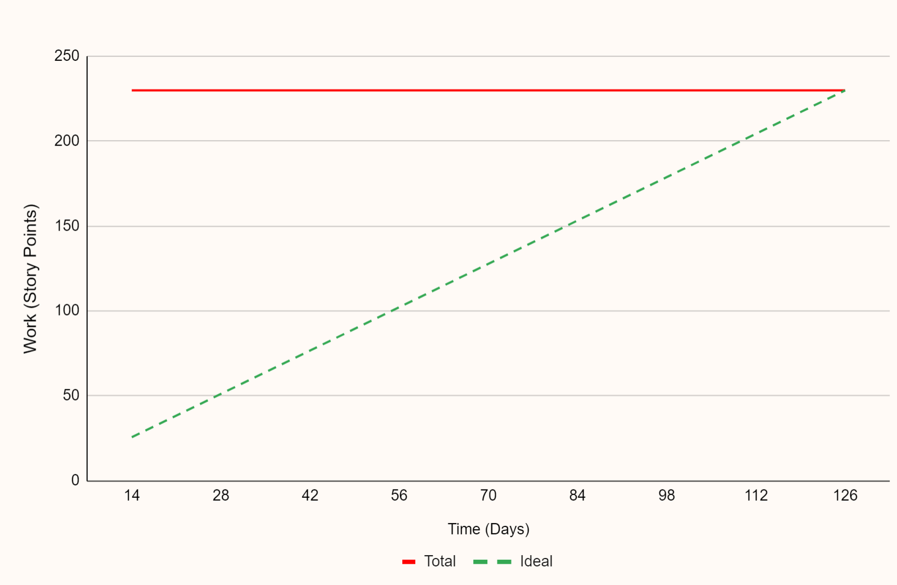

Product Milestones & Burnup Chart¹
SIMPLE
Milestone #1
Database Foundation
Backend MySQL database has been set up and integrated with SeedDMS. Simple UI for Administrative Dashboard deployed.
Milestone #3
User Story 1.0, 1.1, 1.2, 2.3
Milestone #2
User Story 2.0, 2.1, 2.2
Milestone #2
Basic Functionality
EMS web app with login (user authentication) and basic data management features and UI have been deployed and tested.
Milestone #1
User Story 3.0, 3.1, 3.2, 3.3
Milestone #3
Enhanced Web App
EMS is equipped with reporting, dashboards, data visualization, and capable of advanced analytics with Python integration.
[1] Clarios Technology. (n.d.). What Is a Burn-Up Chart? Retrieved from https://www.clariostechnology.com/productivity/blog/whatisaburnupchart/

Slide 40

Product Roadmap
SIMPLE
Design | Database Schema Integration with SeedDMS User Management System Administrative Dashboard | Data Entry Module with fields to manually enter data and import files Supply Chain Module and interface to search and apply filters Login/User Access UI | Refine and Improve Existing Features | Reports & Dashboard Module to create and customize report templates | Interactive and customizable data visualization dashboard views in the Reports & Dashboard Module | Python-MySQL Connection Handler Query Executor Testing Suite
Develop | Data Migration Encryption algorithms and data integrity procedures Comprehensive incident response procedures and data security education | Simple Web App | Refined Web App | Dashboards with customization Report export functionality | Data visualization tools | Integrate Python and data analytics libraries for comprehensive analysis
Test | Data Validation and Error Checking Secure User Access | Test with 3-5 users | Test with 3-5 users | Dashboard Customization Report Accuracy | Data visualization functionality, accuracy, and usability | Run unit tests for functionality Assess processing speed
Milestone #1
Milestone #2
Milestone #3
Project Start
Month 1
Month 2
Month 3
Month 4
Month 5
Month 6

Slide 41
Product Backlog
SIMPLE
Priority | Story ID | Story Points | EMS Entity | DBMS Function
1 | 3.0 | 25 | Administrative Dashboard | Encryption Algorithms, Data Security
2 | 3.1 | 25 | Administrative Dashboard | User Management, System Access, Data Security
3 | 3.3 | 22 | Administrative Dashboard | System Performance Optimization
4 | 3.2 | 25 | Administrative Dashboard | System Monitoring
5 | 2.0 | 25 | Supply Chain Module | SeedDMS Integration
6 | 2.1 | 22 | Data Entry Module | SeedDMS Integration
7 | 2.2 | 22 | Supply Chain Module | SeedDMS Integration
8 | 1.2 | 19 | Supply Chain Module | SeedDMS Integration
9 | 1.0 | 20 | Dashboards & Reports Module | SeedDMS Integration, Python Analytics Engine
10 | 1.1 | 15 | Dashboards & Reports Module | SeedDMS Integration, Python Analytics Engine
11 | 2.3 | 20 | Dashboards & Reports Module | SeedDMS Integration, Python Analytics Engine

Slide 42
Release Criteria
AVERAGE
Focus Area | Release Criteria | Objective | Release Artifact | How
Functionality | System supports at least 95% accuracy: User Authentication Data Management Data Import/Export Dashboard Creation and Customization Report Generation and Export Supplier Document Consolidation | Ensures the system is usable for basic operations | Verify through unit and integration tests that all functions work correctly | Execute test cases that validate each functional requirement
Performance | System processes and visualizes data within 3 seconds for 90% of operations Visualizes data within 24 hours Export process completes within 5 minutes for reports up to 500 MB | Supports efficient operations and ensures usability | Measure the time taken for data processing and visualization tasks | Conduct performance testing using tools like JMeter and LoadRunner
Bug Resolution | 100% of critical-severity and high-priority resolved and no more than 5% of non-critical bugs remain open | Maintains system stability and reliability | Track and prioritize bug resolution | Use JIRA to track bugs, ensuring adherence to the resolution criteria
Security | 100% of sensitive data encrypted and access controls implemented for all user levels | Protects sensitive data from unauthorized access and ensures accountability | Verify encryption and access controls through security audits and penetration testing | Perform security audits and penetration tests to ensure all data is encrypted
Data Migration | 99% of data accurately migrated and integrated from SeedDMS to MySQL | Centralizes environmental data for efficient management | Validate data migration accuracy through data integrity checks and reconciliation processes | Use data migration tools and perform data integrity checks
User Acceptance Testing (UAT) | 85% of UAT participants approve the system functionality and usability | Ensures the system meets user needs and expectations | Collect feedback from UAT participants and measure approval rating based on their experience with the system | Conduct UAT sessions, collect feedback through surveys, and analyze approval ratings

Slide 43
Release Checklist
AVERAGE
Tasks | Artifact | RACI | Phase & Checkpoints
Feature Verification | Requirements and user stories detailing system functionality and acceptance criteria | Responsible: Product Owner Accountable: Scrum Master Consulted: Stakeholders, Developers Informed: Project Manager, Users | Planning Phase: requirements documentation approved; user stories documented
Performance Testing | Plan outlining testing strategies, and reports documenting performance and load testing results | Responsible: Testers Accountable: QA Lead Consulted: Developers, Product Owner Informed: Project Manager | Testing Phase: performance and load testing completed
Bug Fixes | Bug report by priority and severity shows zero critical-severity OPEN bugs and high-priority OPEN bugs | Responsible: Developers Accountable: QA Lead Consulted: Product Owner, Testers Informed: Project Manager, Users | Testing Phase: UAT test completed; system test completed
Security Validation | Summary of findings from security audits and penetration tests | Responsible: Security Team Accountable: Security Lead Consulted: Developers, Testers Informed: Project Manager | Testing Phase: security audits and penetration testing completed
Compliance Check | Documentation proving adherence to relevant regulations and standards | Responsible: Compliance Officer Accountable: Security Lead Consulted: Product Owner Informed: Regulatory Bodies | Review & Approval Phase: compliance review and approved
Data Migration Validation | Details the processes and results of migrating data from SeedDMS to MySQL, ensuring 99% accuracy | Responsible: Database Admin Accountable: Scrum Master Consulted: Developers, Testers Informed: Project Manager | Data Migration Phase: data migration completed and verified
User Documentation | Manuals and materials to help users understand and effectively use the system | Responsible: Technical Writer Accountable: Product Owner Consulted: Developers, Testers Informed: Project Manager, Users | Deployment Phase: user documentation reviewed and approved

Slide 44
Release Roadmap
Timeline | June | July | August | September | October | November
Sprints | 1 | 2 | 3 | 4 | 5 | 6 | 7 | 8 | 9
Increments | 1. System Setup & Core Development |  | 2. Advanced Data Management & User System |  | 3. Data Visualization & Reporting |  | 4. Security Enhancement |  | 5. Compliance and Final Enhancement
Releases | Version 1.0.0 08/21/2024 Alpha Release |  |  |  | Version 1.1.0 09/30/2024 Beta Release |  | Version 1.2.0 11/30/2024 Final Release
Milestones | System Foundation |  |  |  | Basic Functionality |  | System Enhancement
Features | Data migration to MySQL database. Basic and enhanced data management. Advanced user management and data import/export. Secure user authentication and access control. |  |  |  | Interactive dashboards and reporting tools. Real-time data updates with filtering. |  | Advanced data encryption and security. Compliance with regulatory requirements. Final refinements based on user feedback.
Testing | Data migration and functional testing to ensure data integrity and core managing functionalities. User acceptance testing for data import/export. Integration testing for user authentication and access controls. |  |  |  | UAT for dashboards & reporting. Usability testing to ensure user needs met. |  | Security and penetration testing. Final system testing and compliance verification. Regression testing to ensure new changes do not affect existing functionalities.

Slide 45
SIMPLE
Bug Management Workflow
 | Description
Bug Reporting | A tester discovers a bug during integration testing. The tester logs the bug in Jira with all necessary details and attaches relevant screenshots.
Bug Triage | During the triage meeting, the bug is reviewed, given a high severity and P1 priority due to its impact on a critical functionality. The bug is assigned to a developer with the relevant expertise.
Bug Fixing | The developer starts working on the bug, implements the fix, and updates the bug status to "In Progress." Once the fix is implemented, the developer updates the status to "Ready for Review."
Testing | A peer developer reviews the code changes and approves them. The tester performs regression testing to ensure the fix hasn’t introduced new issues.
Release Readiness | Before the release, a final review of all bug statuses is conducted. The fixed version is deployed to the staging environment for UAT. After successful UAT, stakeholders sign off on the release.
Post-Release | The application is monitored, and any new bugs reported by users are logged and addressed as per their severity and priority.

Slide 46
SIMPLE
Bug Management Steps
Step | Description
Bug Reporting | Bug Tracking Tool: Jira, Bugzilla, GitHub Issues. Bug Report Template: Bug ID, Status, Severity, Priority, Title, Description, Steps to Reproduce, Expected Result, Actual Result, Screenshots/Attachments, Reporter Information, Environment Details (OS, Browser, etc.), Assignee Bug Status Description: New: The bug has been reported and is awaiting triage. In Progress: The bug has been assigned to a developer and is currently being worked on. Resolved: The developer has fixed the bug, and it is awaiting verification. In Review: The bug fix is undergoing peer review. Verified: The bug fix has been tested and verified by the QA team. Closed: The bug has been fixed, verified, and no further action is needed. Reopened: The bug has reoccurred, or the fix was not effective, and it needs to be addressed again. Deferred: The bug has been acknowledged but will not be fixed in the current release cycle. Duplicate: The bug report is a duplicate of another already reported bug. Rejected: The bug report is invalid or not considered a bug.
Bug Prioritization | Severity Levels: Critical: Blocks development/testing, no workaround. High: Major functionality is impacted, workaround is available. Medium: Non-critical functionality impacted. Low: Minor issues or cosmetic defects. Priority Levels: P1 (High): Fix immediately P2 (Medium): Fix in next sprint/release P3 (Low): Fix when possible.

Slide 47
Bug Management Steps
SIMPLE
Step | Description
Bug Triage Meetings | Frequency: Conduct triage meetings twice a week. Attendees: Product Owner, Scrum Master, Developers, Testers. Agenda: Review new bugs, update the status of existing bugs, prioritize and assign bugs.
Bug Fixing Process | Assignment: Bugs are assigned to developers based on expertise and current workload. Fix Implementation: Developers fix the bugs and document the changes made. Code Review: Peer review of bug fixes to ensure quality and prevent regressions.
Testing | Unit Testing: Automated tests to ensure individual components work correctly. Integration Testing: Tests to ensure modules work together as expected. Regression Testing: Re-test previously working functionality to ensure new changes haven’t introduced new bugs. User Acceptance Testing (UAT): Involve a select group of end-users to validate the system meets the business requirements.
Release Readiness | Bug Status Review: Before the release, review the status of all bugs. Ensure that all critical and high-priority bugs are resolved. Staging Environment: Deploy the application to a staging environment for final testing. Sign-off: Obtain sign-off from key stakeholders before going live.

Slide 48
SIMPLE
Software Disasters & Mitigation
Disaster | Description | Impact | Mitigation
Data Breach¹ | Data breach occurs when unauthorized individuals gain access to sensitive environmental data stored within our system, such as customer information, compliance records, or research data. | Compromised user privacy, loss of trust, legal consequences. | Enforce strict access controls and authentication mechanisms (User Story 3.1). Implement robust encryption protocols to safeguard sensitive data stored within the system (User Story 3.3). Conduct regular security audits and vulnerability assessments (User Story 3.3). Provide user education on data security.
Data Loss² | Data loss occurs when critical environmental data stored within our system is accidentally deleted, corrupted, or becomes inaccessible due to software errors, hardware failures, or human error. | Loss of valuable data, hindrance to decision-making processes. | Implement data backup and recovery procedures (User Story 3.0). Conduct regular backups of environmental data (User Story 3.0). Test backup and recovery processes for data integrity (User Story 3.1).
System Downtime³ | System downtime occurs when our Environmental Management System experiences prolonged periods of unavailability due to software bugs, hardware failures, or cyberattacks | Disrupted access to critical environmental data, loss of productivity | Implement redundancy and failover mechanisms (User Story 3.1). Conduct regular system maintenance and updates and monitor system health and performance (User Story 3.2). Establish incident response procedures (User Story 3.1, 3.3).
[1]. IBM. (n.d.). Data Breach. Retrieved from https://www.ibm.com/topics/data-breach
[2]. Wikipedia. (2024, Apr 14). Data loss. In Wikipedia. Retrieved from https://en.wikipedia.org/wiki/Data_loss
[3]. Legowski, A. (2022, June 6). System Downtime. Pretius Blog. Retrieved from https://pretius.com/blog/system-downtime/

Slide 49
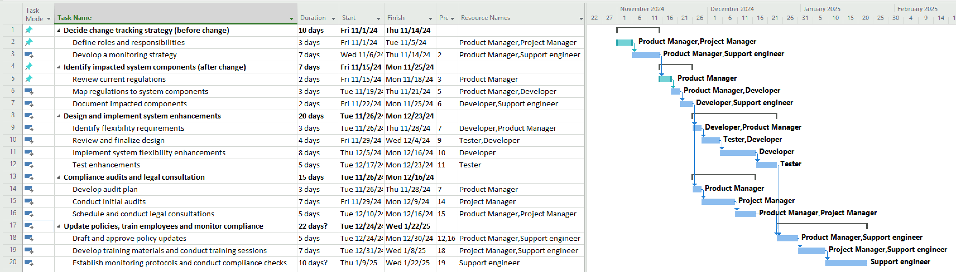
Mitigation Plan for Regulatory Change
SIMPLE

Slide 50
Test Strategy¹
SIMPLE
Test Strategy | Objective | Approach | Tools
Test Development | Develop detailed test cases and scripts based on the user stories | Write test cases for each user story and increment. Use Behavior-Driven Development (BDD) to create test scenarios in Cucumber. Ensure test cases cover functional, integration, system, security, performance, and compliance aspects. | Cucumber for BDD, Selenium for automation, Postman
Test Execution³ | Execute test cases to validate each increment and ensure the system meets requirements. | Unit Testing: Validate individual components. Functional Testing: Validate functionalities as described in user stories. Integration Testing: Ensure integrated components work together. System Testing: Validate the complete system against requirements. Security Testing: Test for vulnerabilities and access controls. Performance Testing: Assess system performance under load. Regression Testing: Ensure new changes do not affect existing functionalities. User Acceptance Testing (UAT): Validate system functionality from an end-user perspective. | Selenium, JIRA, LoadRunner, JMeter, OWASP ZAP.
Test Strategy: https://katalon.com/resources-center/blog/test-strategy
Tools : https://www.geeksforgeeks.org/software-testing-tools/
Type of testing : https://www.geeksforgeeks.org/types-software-testing/

Slide 51
Test Strategy²
SIMPLE
Test Strategy | Objective | Approach | Tools
Performance and Security Testing | Validate system performance and security to ensure reliability and data protection | Simulate peak load conditions using LoadRunner/JMeter Identify and mitigate vulnerabilities using OWASP ZAP | LoadRunner, JMeter, OWASP ZAP
User Acceptance Testing (UAT) | Ensure the system meets business requirements and user expectations. | Engage end-users to validate the system. Conduct testing sessions to collect user feedback. Make necessary adjustments based on feedback. | UAT checklists, feedback forms
Compliance and Reporting | Ensure the system complies with all regulatory and compliance requirements. | Conduct compliance tests to verify adherence to regulations. Validate reporting functionalities for accuracy. | Compliance testing tools, Selenium for automated tests
Continuous Improvement | Continuously improve testing processes and methodologies. | Collect feedback from testing team and stakeholders. Analyze testing metrics and outcomes. Implement process improvements based on feedback and analysis. | JIRA for feedback collection, data analysis tools for metrics
Test Strategy: https://katalon.com/resources-center/blog/test-strategy
Tools : https://www.geeksforgeeks.org/software-testing-tools/
Type of testing : https://www.geeksforgeeks.org/types-software-testing/

Slide 52
Test Methodology
SIMPLE
Testing Type | User Story | Objective | Outcome | Test Tools | Test Environment | Acceptance Criteria
Unit Testing | All user stories | Validate individual components for functionality and reliability. | Ensure each component works as expected in isolation. | JUnit, NUnit, PyTest | Development environment | Components meet specified functional requirements and pass all unit tests
Integration Testing | As a Supply Chain Ops Manager, want data consolidated in the Supply Chain Module from various supply chain aspects. ( User Story 2.0) | Ensure seamless integration of data from supplier information, raw material sourcing, manufacturing processes, transportation and logistics, and inventory into the module. | Data from all sources is accurately integrated and visualized within the Supply Chain Module. | Postman, SoapUI | Integration testing platform. | All data sources are integrated without errors and display correctly in the module.
 | As a Supply Chain Ops Manager, I need APIs that facilitate data integration and extraction for detailed analysis. (User Story 2.2) | Assess API functionality for system integration and robust data handling under operational conditions | APIs effectively integrate and perform data handling. | Postman, SoapUI | Integrated development environment (IDE) with live data streams. | APIs demonstrate successful integration and data handling capabilities.
Avipsha Ghosh, April 21, 2022 https://www.headspin.io/blog/unit-integration-and-functional-testing-4-main-points-of-difference

Slide 53
Test Methodology
SIMPLE
Testing Type | User Story | Objective | Outcome | Test Tools | Test Environment | Acceptance Criteria
Performance Testing | As a Supply Chain Ops Manager, I need the system to perform efficiently and handle operations quickly. (User Story 2.0) | Test system performance to handle simultaneous data queries and operations effectively and efficiently. | System processes and visualizes data within acceptable time limits, supporting efficient operations. | JMeter, LoadRunner | Production-like environment. | System response times for data processing and visualization are within acceptable limits.
 | As a Supply Chain Ops Manager, I need quick processing and visualization of environmental data. (User Story 2.2) | Ensure the system processes data and provides visualizations within 24 hours. | Data is processed and visualized within the 24-hour timeframe. | JMeter, LoadRunner | Production-like test environment. | System meets the 24-hour processing and visualization deadline.
 | Export process efficiency. (User Story 2.3) | Ensure that the export process does not exceed 5 minutes for reports up to 500 MB. | Export completes within 5 minutes. | JMeter, LoadRunner | Production-like environment | Export process is efficient and meets the 5-minute requirement.
Tricentis Staff. Mar 21, 2024 (https://www.tricentis.com/learn/performance-testing)

Slide 54
Test Methodology
SIMPLE
Testing Type | User Story | Objective | Outcome | Test Tools | Test Environment | Acceptance Criteria
Reliability Testing | The EMS should have a system uptime of at least 99.5%. (User Story 2.0) | Confirm the system meets the uptime requirement to ensure continuous operation. | System demonstrates reliability with at least 99.5% uptime. | Pingdom, Uptime Robot | Operational environment. | System uptime meets or exceeds 99.5%, ensuring reliability for operational continuity.
Data Coverage Testing | Coverage of at least 95% of active suppliers. (User Story 2.1) | Verify that the system includes data from at least 95% of active suppliers in each generated report. | Comprehensive data coverage in reports. | SQL queries, Data validation tools | Development environment | Reports include data from at least 95% of active suppliers.
Data Accuracy Testing | Current and correct data on supplier performance. (User Story 2.1) | Confirm that reports reflect the latest and most accurate data on supplier performance. | Data in reports is up-to-date and correct. | Data verification tools, Database audits | Production environment | Data is verified as current and accurate in final reports.
E. W. Dijkstra, JANUARY 28, 2021(https://www.gremlin.com/blog/reliability-testing-definition-history-methods-and-examples)
Helen Soloveichik, August 30, 2023 (https://www.ibm.com/blog/7-data-testing-methods/)

Slide 55
Test Methodology
SIMPLE
Testing Type | User Story | Objective | Outcome | Test Tools | Test Environment | Acceptance Criteria
Usability Testing | Report accessibility and readability. (User Story 2.1) | Test the ease of access and the readability of the reports by supply chain management team. | Reports are easily accessible and interpretable. | User testing protocols, Survey feedback | Staging environment | Reports are user-friendly and easily interpretable.
Compliance Testing | As a Supply Chain Ops Manager, I need automated compliance reports generated monthly. (User Story 2.2) | Test the system's ability to automate and schedule environmental compliance reports. | Compliance reports are generated on schedule and meet regulatory standards. | ComplianceQuest, Qualys | Cloud-based environment with compliance data. | Automated reports are generated monthly and adhere to compliance standards.
Security Testing | Maintaining a log of export activities. (User Story 2.3) | Confirm that the system logs all export activities accurately, including date, time, user, and file size. | Complete and accurate activity logs are maintained. | Security audit tools, Log analysis tools | Production environment | Activity logs are detailed and comply with audit standards.
System Testing | Comprehensive system validation | Validate the complete and integrated system to ensure it meets all specified requirements. | Ensure the entire system works as intended when all components are integrated. | Selenium, JIRA | Staging and production environments | System functions correctly in an integrated environment, meeting all functional and non-functional requirements.
Hotjar, 9 OCT 2023 (https://www.hotjar.com/usability-testing/)
Oliver Moradov, May 29, 2022 (https://brightsec.com/blog/security-testing/)

Slide 56
Test Methodology
SIMPLE
Testing Type | User Story | Objective | Outcome | Test Tools | Test Environment | Acceptance Criteria
Functional Testing | Metrics on delivery time, cost compliance, etc. (User Story 2.1) | Ensure that all required metrics are correctly calculated and displayed in reports. | Accurate and complete metrics display. | Selenium, TestComplete | Testing environment | Reports accurately reflect all specified metrics.
 | As a Supply Chain Ops Manager, I need to analyze environmental data including historical data up to five years. (User Story 2.2) | Verify system capabilities to capture and analyze environmental metrics and historical data. | System correctly handles specified metrics and historical data analysis. | TestComplete, Selenium | Development and staging environment. | Accurate capture and analysis of specified environmental metrics.
 | Ability to export data in multiple formats. (User Story 2.3) | Verify that the system supports data export in at least three formats: CSV, Excel, PDF, XML, JSON. | Successful data export in chosen formats. | Selenium, Postman | Development environment | Data export is supported in at least three specified formats.
UAT | Final system validation | Ensure the system meets business requirements and user expectations. | Validate system functionality from an end-user perspective | UAT checklists, Feedback forms | Staging and production environment | Users confirm the system meets all their requirements and is ready for deployment.
Regression Testing | All user stories | Ensure new code changes do not adversely affect existing functionalities. | Maintain system stability after changes or updates. | Selenium, JIRA, TestRail | Development and staging environment | System remains stable with no functional regressions after updates.
Angela Hausman, August 22, 2023 (https://www.hausmanmarketingletter.com/software-testing-user-acceptance-testing-vs-regression-testing/)

Slide 57
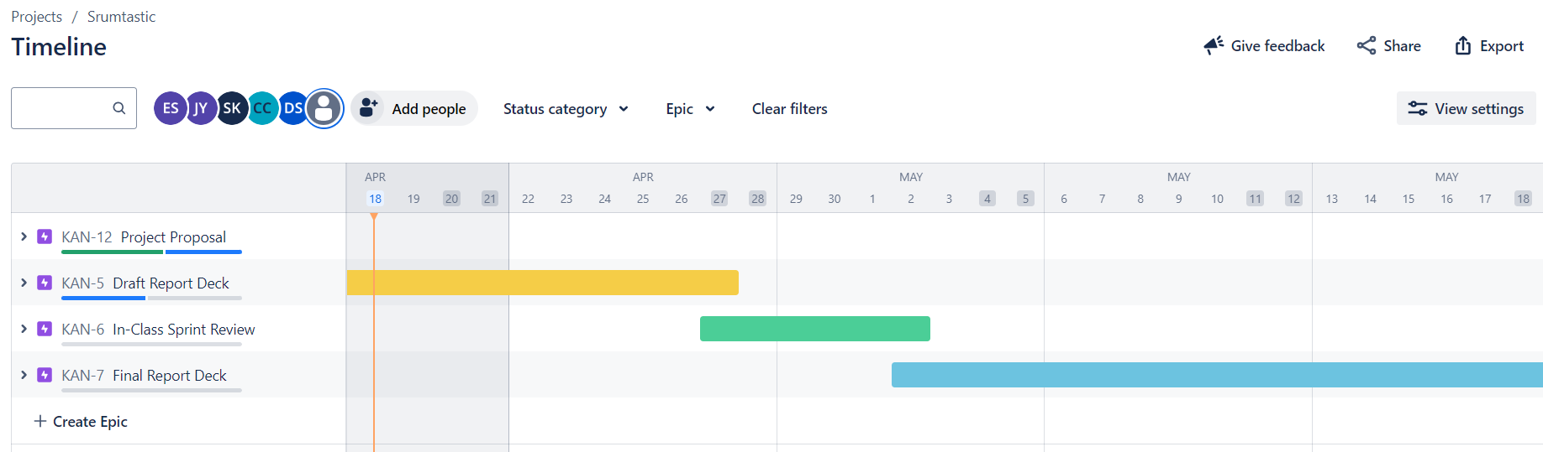

OSS Project Sprint Plan: Timeline
SIMPLE

Slide 58
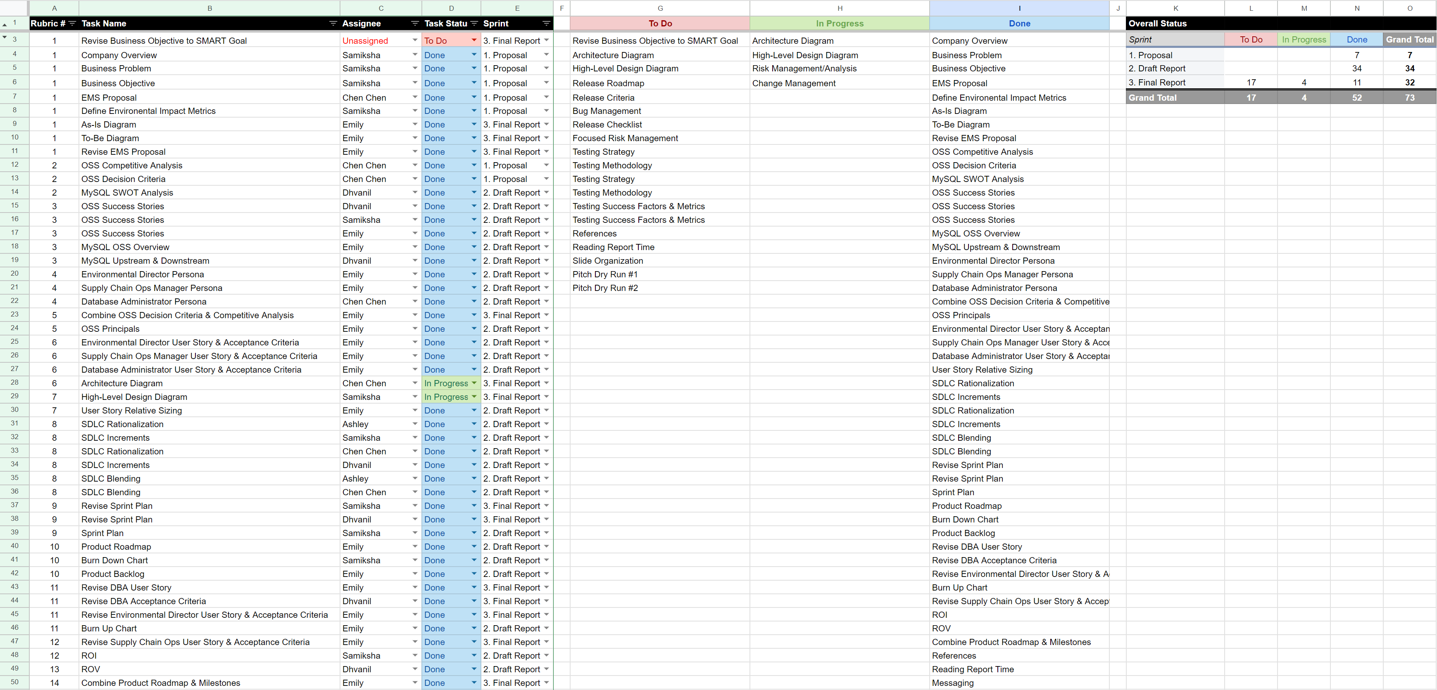
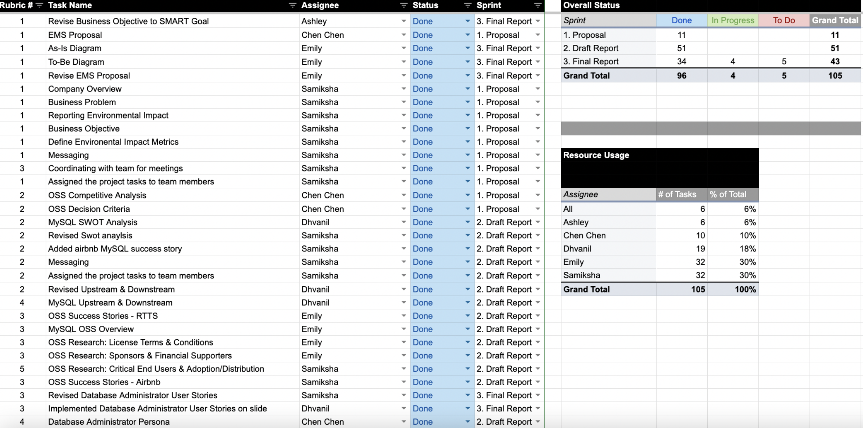
OSS Project Sprint Plan: Project Tracker
SIMPLE

Slide 59
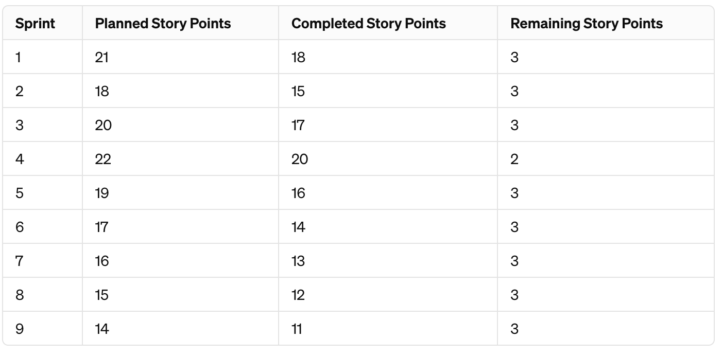
Burndown Chart
SIMPLE

